Slide 1
Lecture 5: Environmental Econometrics
Prof. Parthum
Environmental Economics Econ 475

Slide 2
Follow-up from Last Class
How can we ensure that economic research remains positive when research questions are inheritably normative?

Slide 3
Follow-up from Last Class
How can we ensure that economic research remains positive when research questions are inheritably normative?
Subjectivity is also a part of research. Decisions must be made, and if those decisions are made in concert with other researchers with different background and experience, we stand a better chance of making the “best” one.

Slide 4
Follow-up from Last Class
How can we ensure that economic research remains positive when research questions are inheritably normative?
Subjectivity is also a part of research. Decisions must be made, and if those decisions are made in concert with other researchers with different background and experience, we stand a better chance of making the “best” one.
Lastly, environmental economics would do well to push the frontiers of science when it comes to asking difficult questions, especially when we are interested in solving society’s problems (or at least contributing to the conversation). This is an active area of research and you all can make a career out of advancing these methods!

Slide 5
Econometrics, in General
Knowledge and experience with econometrics can get you a job! A really good job, a good pre-doc, research assistantship, etc.
There are amazing resources out there.
Dr. Jennifer Doleac’s Probable Causation Podcast
Dr. Scott Cunningham’s Substack, Journal of Human Resources threads, Podcast, and Causal Inference: The Mixtape book
Dr. Nick Huntington-Klein’s website has a TON of resources on econometrics, methods, causality, and examples with replication
Dr. Patty Champ et al. A Primer in Nonmarket Valuation (PDF version available here for free, and Amazon link here)
Dr. Elieen Tipoe and Dr. Ralph Becker’s Doing Economics

Slide 6
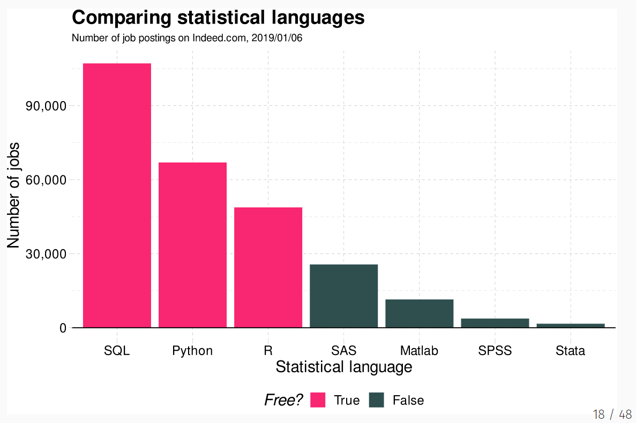
An aside:
Source

Slide 7
Why Do Economists use Econometrics?
Is econometrics just the economics version of statistics?
Economy + Tricks from statistics = econometrics
Uses the tricks (toolkit) from statistics and applies them to questions related to problems and phenomena within economics.

Slide 8
Why Do Economists use Econometrics?
Is econometrics just the economics version of statistics?
Economy + Tricks from statistics = econometrics
Uses the tricks (toolkit) from statistics and applies them to questions related to problems and phenomena within economics.
When applying a data science toolkit to economic problems, there is oft a specific focus on causality
Why is there such a focus on causality? Correlations are still interesting.

Slide 9
Why Do Economists use Econometrics?
Is econometrics just the economics version of statistics?
Economy + Tricks from statistics = econometrics
Uses the tricks (toolkit) from statistics and applies them to questions related to problems and phenomena within economics.
When applying a data science toolkit to economic problems, there is oft a specific focus on causality
Why is there such a focus on causality? Correlations are still interesting.
We want to know with some degree of confidence that an intervention/policy etc. affects an outcome. Resources are constrained and interventions cost money!

Slide 10
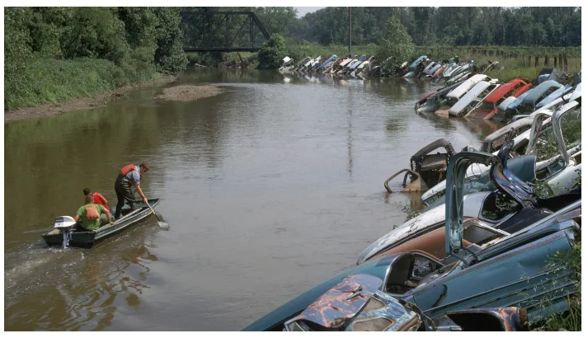

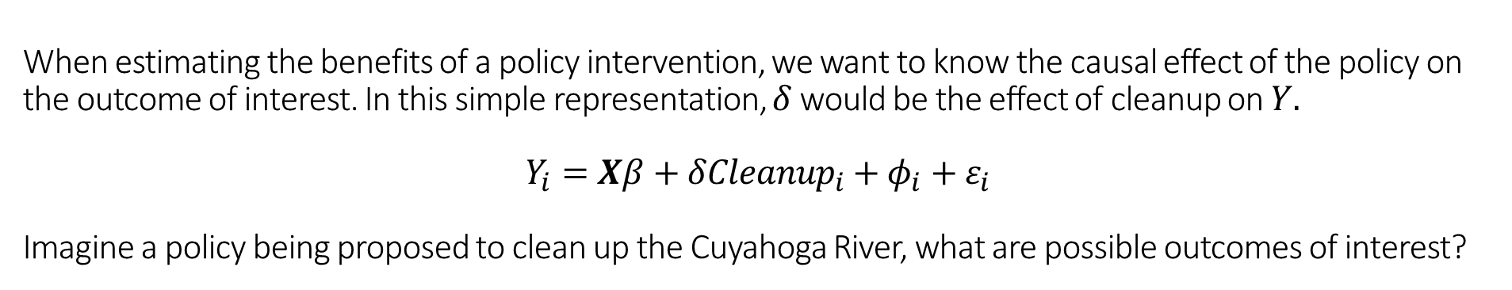
When estimating the benefits of a policy intervention, we want to know the causal effect of the policy on the outcome of interest. In this simple representation, $δ$ would be the effect of cleanup on $Y.$
$$Y_{i}=Xβ+δ{Cleanup}_{i}+φ_{i}+ε_{i}$$
Imagine a policy being proposed to clean up the Cuyahoga River, what are possible outcomes of interest?
$Y=$
Source: history.com

Slide 11
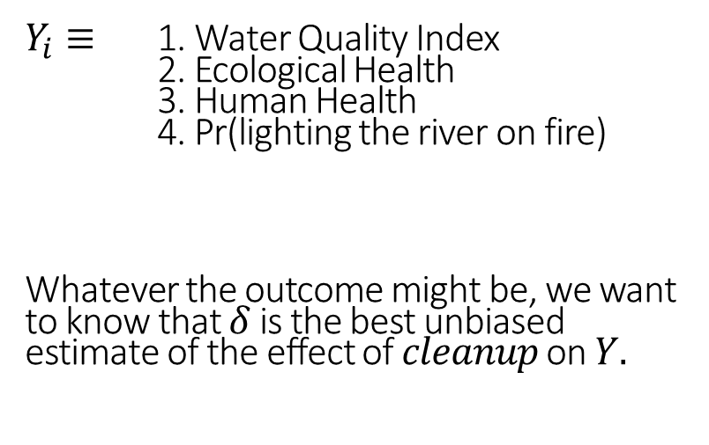
When estimating the benefits of a policy intervention, we want to know the causal effect of the policy on the outcome of interest. In this simple representation, $δ$ would be the effect of cleanup on $Y.$
$$Y_{i}=Xβ+δ{Cleanup}_{i}+φ_{i}+ε_{i}$$
Imagine a policy being proposed to clean up the Cuyahoga River, what are possible outcomes of interest?
$Y_{i}≡$ 1. Water Quality Index
2. Ecological Health
3. Human Health
4. Pr(lighting the river on fire)
Whatever the outcome might be, we want to know that $δ$ is the best unbiased estimate of the effect of $cleanup$ on $Y.$
Source: history.com

Slide 12
Environmental Econometrics
Econometrics used within the field of environmental economics is not inherently different than approaches used in other fields.

Slide 13
Environmental Econometrics
Econometrics used within the field of environmental economics is not inherently different than approaches used in other fields.
However, in many cases the research questions are different and, therefore, require different methods.

Slide 14
Environmental Econometrics
Econometrics used within the field of environmental economics is not inherently different than approaches used in other fields.
However, in many cases the research questions are different and, therefore, require different methods.
Because the research questions are different, environmental economists have advanced specific areas of econometrics to address hurdles that other fields may not face. For example, constructing hypothetical markets to estimate the value of nonmarket goods and services, specifically nonuse or nonlocal goods.

Slide 15
Environmental Econometrics
Travel cost methods
Primarily focuses on the value of things like recreation
Exploits variation in travel distance (the “cost”) to identify the value of “a trip”.

Slide 16
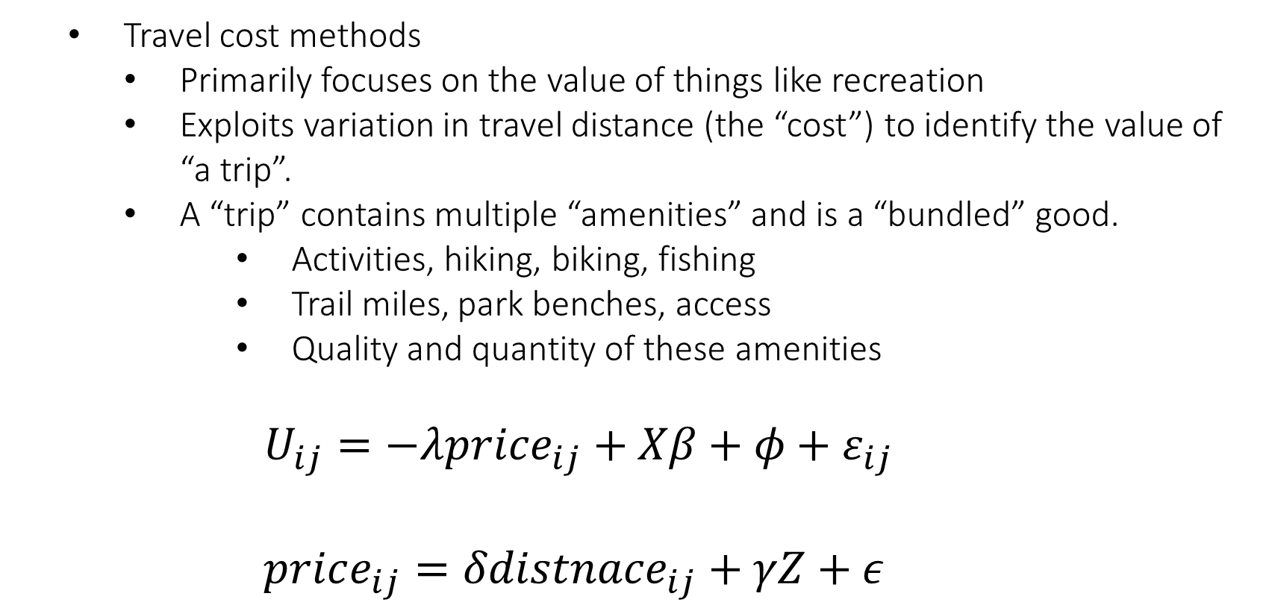
Environmental Econometrics
Travel cost methods
Primarily focuses on the value of things like recreation
Exploits variation in travel distance (the “cost”) to identify the value of “a trip”.
A “trip” contains multiple “amenities” and is a “bundled” good.
Activities, hiking, biking, fishing
Trail miles, park benches, access
Quality and quantity of these amenities
$$U_{ij}=−λprice_{ij}+Xβ+φ+ε_{ij}$$
$$price_{ij}=δdistnace_{ij}+γZ+ε$$

Slide 17
Environmental Econometrics
Hedonic Valuation
Similar to travel cost, but primarily focuses on the value of things like local amenities (parks, rivers, lakes, etc.)

Slide 18
Environmental Econometrics
Hedonic Valuation
Similar to travel cost, but primarily focuses on the value of things like local amenities (parks, rivers, lakes, etc.)
The difference between travel cost and hedonics is that many things hedonic valuation address, like local parks, aren’t necessarily worth traveling to, but still provide use-value to locals.

Slide 19
Environmental Econometrics
Hedonic Valuation
Similar to travel cost, but primarily focuses on the value of things like local amenities (parks, rivers, lakes, etc.)
The difference between travel cost and hedonics is that many things hedonic valuation address, like local parks, aren’t necessarily worth traveling to, but still provide use-value to locals.
Exploits variation in distance from a place of residence to the amenity

Slide 20
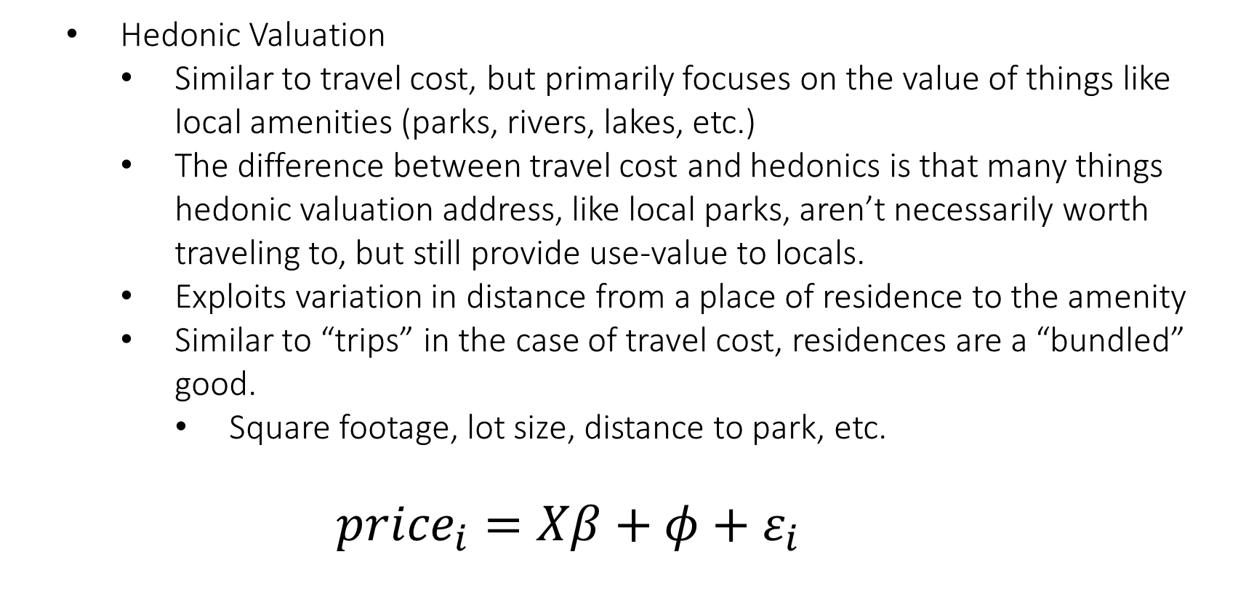
Environmental Econometrics
Hedonic Valuation
Similar to travel cost, but primarily focuses on the value of things like local amenities (parks, rivers, lakes, etc.)
The difference between travel cost and hedonics is that many things hedonic valuation address, like local parks, aren’t necessarily worth traveling to, but still provide use-value to locals.
Exploits variation in distance from a place of residence to the amenity
Similar to “trips” in the case of travel cost, residences are a “bundled” good.
Square footage, lot size, distance to park, etc.
$${price}_{i}=Xβ+φ+ε_{i}$$

Slide 21
Environmental Econometrics
Stated Preference
Because markets for nonmarket goods don’t exist, sometimes it is useful to create them!

Slide 22
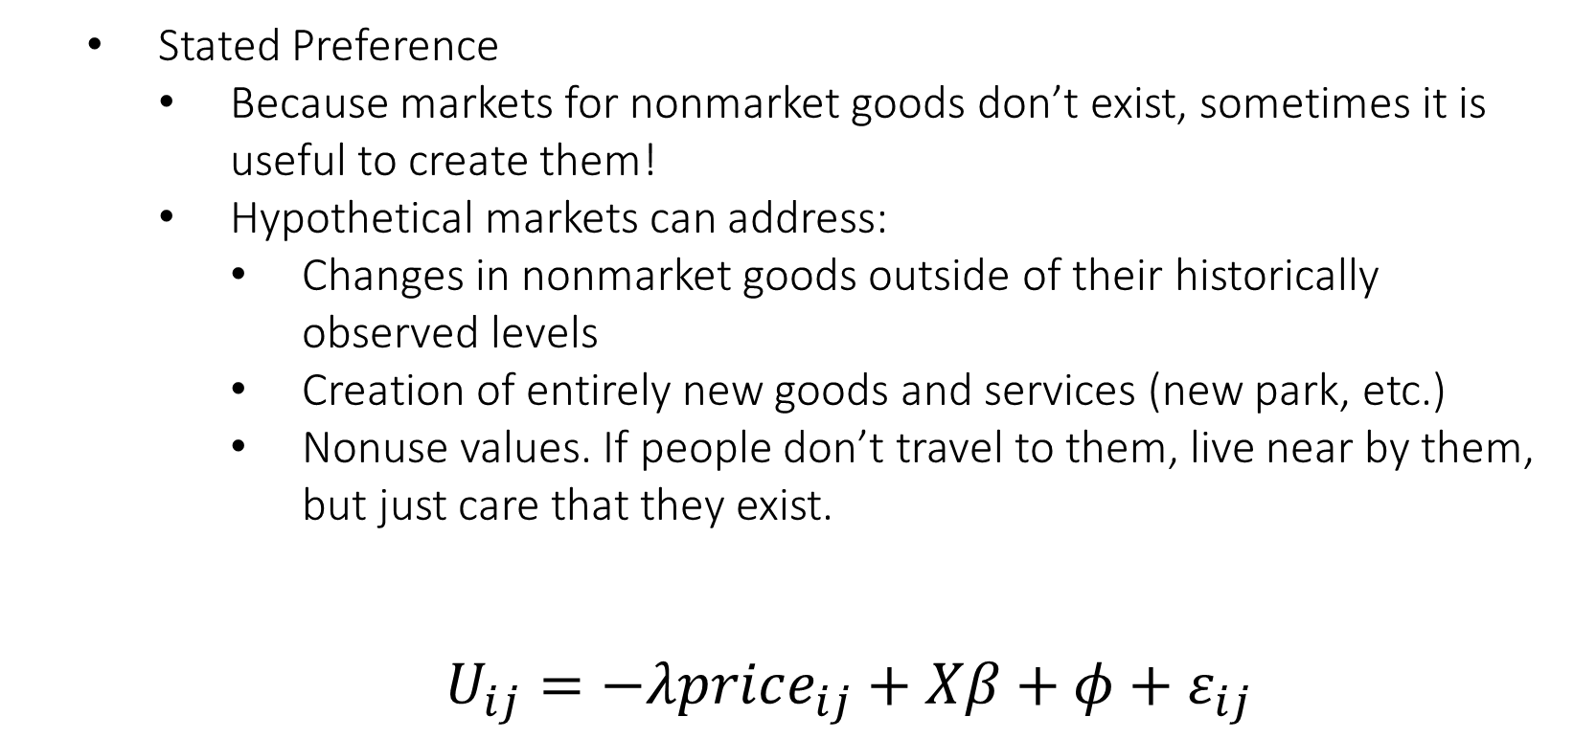
Environmental Econometrics
Stated Preference
Because markets for nonmarket goods don’t exist, sometimes it is useful to create them!
Hypothetical markets can address:
Changes in nonmarket goods outside of their historically observed levels
Creation of entirely new goods and services (new park, etc.)
Nonuse values. If people don’t travel to them, live near by them, but just care that they exist.
$U_{ij}=−λprice_{ij}+Xβ+φ+ε_{ij}$

Slide 23
Environmental Econometrics
Defensive Behavior
People are exposed to various levels of pollution. This exposure presents risks, often in the for of lost productivity or lost workdays.

Slide 24
Environmental Econometrics
Defensive Behavior
People are exposed to various levels of pollution. This exposure presents risks, often in the for of lost productivity or lost workdays.
To help protect themselves from this reduction in productivity, people can invest in expenditures that will reduce the severity or length of the illness.

Slide 25
Environmental Econometrics
Defensive Behavior
People are exposed to various levels of pollution. This exposure presents risks, often in the for of lost productivity or lost workdays.
To help protect themselves from this reduction in productivity, people can invest in expenditures that will reduce the severity or length of the illness.
Cost of illness takes many forms, but personal cost of illness is one.

Slide 26
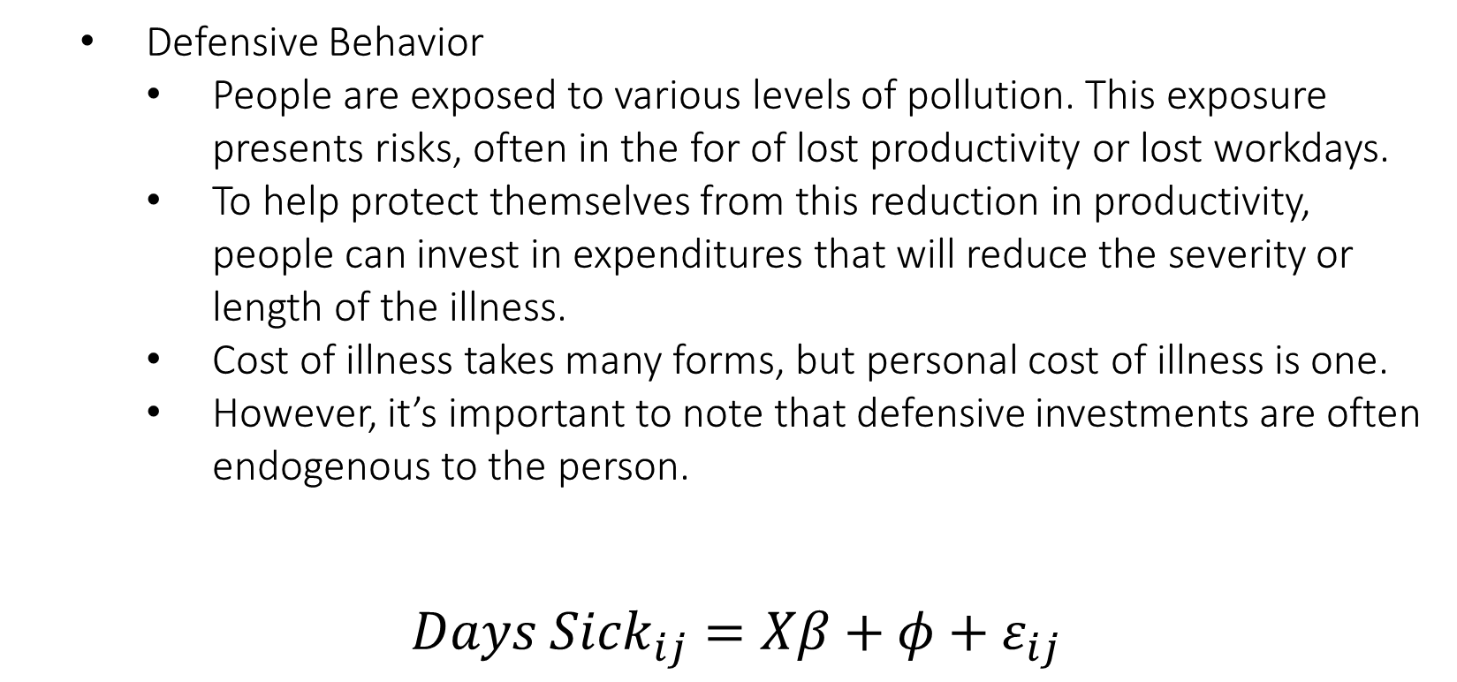
Environmental Econometrics
Defensive Behavior
People are exposed to various levels of pollution. This exposure presents risks, often in the for of lost productivity or lost workdays.
To help protect themselves from this reduction in productivity, people can invest in expenditures that will reduce the severity or length of the illness.
Cost of illness takes many forms, but personal cost of illness is one.
However, it’s important to note that defensive investments are often endogenous to the person.
${Days Sick}_{ij}=Xβ+φ+ε_{ij}$

Slide 27
Environmental Econometrics
Linking research questions to econometric approaches requires careful thought about what the question is, what you believe the answer might look like, and the available data.
I often have a research question and think about what the “ideal” data might look like. Knowing the “ideal” data often doesn’t exist helps guide which approach I am going to use.
Lastly, think about unique events that happen in our everyday lives that act as natural experiments. Did something occur suddenly and without expectation? Do states have very different policies while the communities on either side of the border remain the same?

Slide 28
Module 2
Major focus on academic research articles in the field of environmental economics
Each class we will be reviewing articles, their methods, and their conclusions
Reading academic articles is really hard (at first). But there is a lot of great advice out there on how to best get started.
How to Read Journal Articles like a Professor

Slide 29
Reflection Post
Grading Rubric
Do not summarize the podcast. Skip to the good part:
your experience with the material and what you believe the experience of others is
Grading:
50 points: For connecting your experience to the material in a concise way. E.g. “Dr. Spiller talks about the location of schools and the schools I attended growing up…”
50 points: For connecting your experience with the material to what you think others in your neighborhood, city, state, etc. faced. Can those experiences be generalized to other towns/states/countries? If not, why? How do you believe the experience differs?

